Slide 1

FINAL PROJECT
Virtual Internship(30-May 2022)
CUSTOMER SEGMENTATION

Slide 2
Team Members
Ray Ng
rayng2018@gmail.com
Canada
University of British Columbia
Specialization: Data Science
Rita Uzoka
rita.uzoka@yahoo.com
United Kingdom
Sheffield Hallam University
Specialization: Data Science
Fatemeh Bagheri
f.bagheri13@gmail.com
France
Université Jean Monnet St Etienne - Université de Lyon
Your Specialization: Data Science

Slide 3
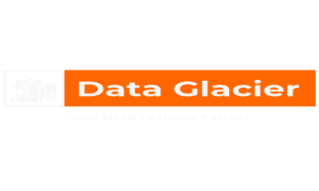
Background –G2M(cab industry) case study
XYZ bank wants to roll out Christmas offers to their customers. But the bank does not want to roll out the same offer to all customers, instead they want to roll out personalized offers to sets of customers. If they manually start understanding the category of customer, then this will not be efficient and, they will not be able to uncover the hidden pattern in the data ( pattern which groups certain kinds of customer in one category). Bank approached ABC analytics company to solve their problem. Bank also shared information with ABC analytics that they don't want more than 5 groups as this will be inefficient for their campaign.
Objective : ABC analytics should try to understand certain patterns in customer behaviour, which include relations between province, sex, seniority, etc. and household income. ABC must find at most five groups in which customers share common behaviours.
The analysis has been divided into four parts:
Description of the Datasets
Exploratory Data Analysis
Tools and Techniques
Implementation
Results
Conclusion

Slide 4
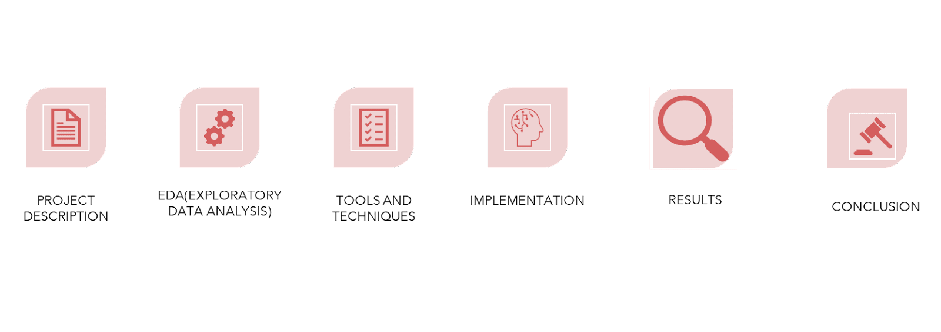
Agenda

Slide 5
Description of the Datasets
48 Features
Timeframe of the data: 1995-01-01 to 2015-12-31
Total data points :1000000
Total number of observations | 1000000
Total number of files | 1
Total number of features | 48
Base format of the file | .csv
Size of the data | 154 MB

Slide 6
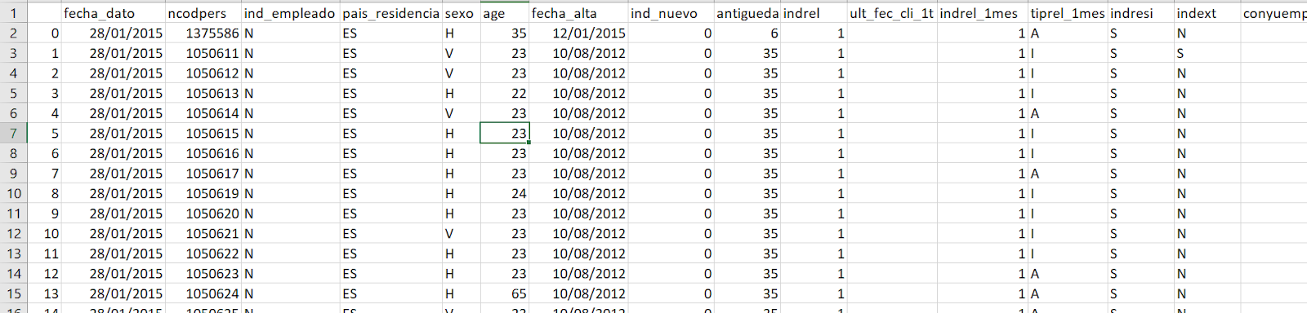
Description of the Datasets

Slide 7
Description of the dataset:What kind of data does each column hold in the raw data?
Unnamed: 0: [ 0 1 2 ... 999997 999998 999999]
fecha_dato: ['2015-01-28' '2015-02-28']
ncodpers: [1375586 1050611 1050612 ... 1149999 1150908 1183305]
ind_empleado: ['N' nan 'A' 'B' 'F' 'S']
pais_residencia: ['ES' nan 'CA' 'CH' 'CL' 'IE' 'AT' 'NL' 'FR' 'GB' 'DE' 'DO' 'BE' 'AR' 'VE'
'US' 'MX' 'BR' 'IT' 'EC' 'PE' 'CO' 'HN' 'FI' 'SE' 'AL' 'PT' 'MZ' 'CN'

Slide 8
Description of the dataset: How many NA (Missing data)are in each column?
Unnamed: 0: 0
fecha_dato: 0
ncodpers: 0
ind_empleado: 10782
pais_residencia: 10782
sexo: 10786
age: 10782
fecha_alta: 10782
ind_nuevo: 10782
antiguedad: 10782
indrel: 10782
ult_fec_cli_1t: 998899
indrel_1mes: 10782

Slide 9
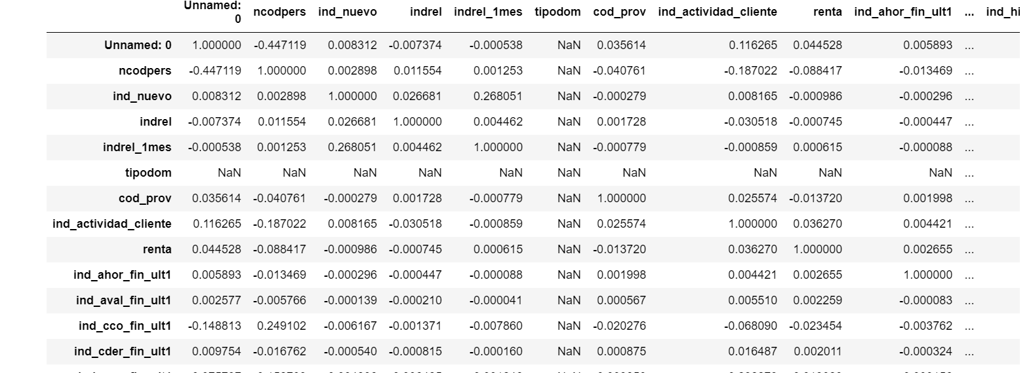
Description of the dataset: Correlation of selected variables
Multivariate Correlation: We try to find out if there is a linear relationship between the variables in the masterdata since we have more than one variable to relate with.

Slide 10
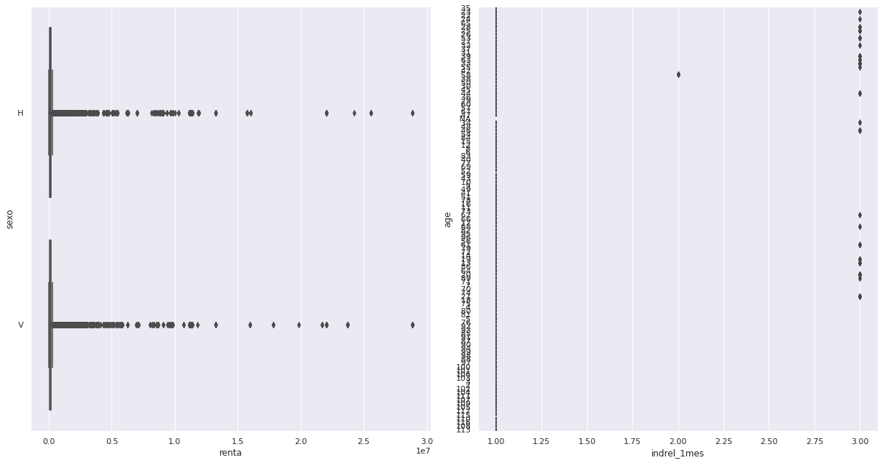
Description of the dataset: Outliers in numerical data

Slide 11
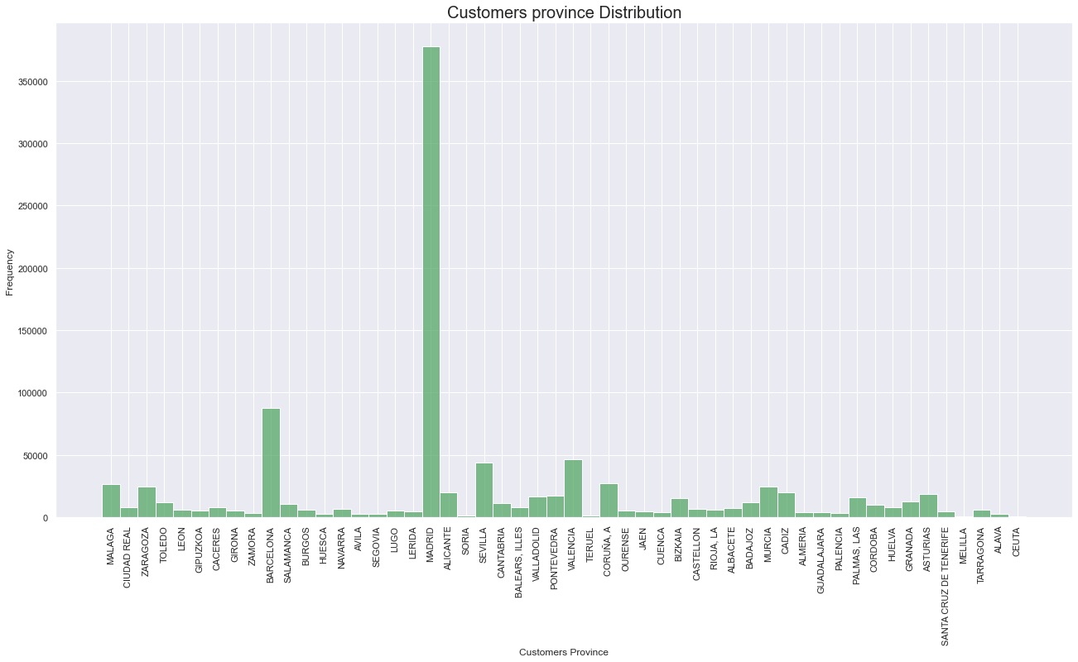
EDA: Share of customers by province
The graph below shows that most of the customers are located in Madrid.

Slide 12
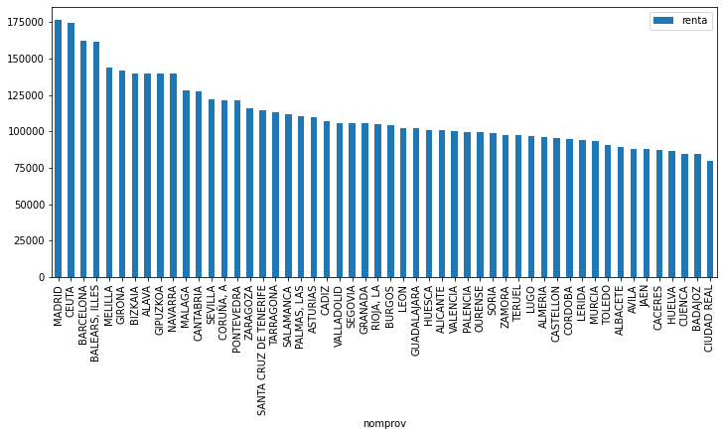
EDA: Average household income by province
The graph below shows that Madrid has the highest household income.

Slide 13
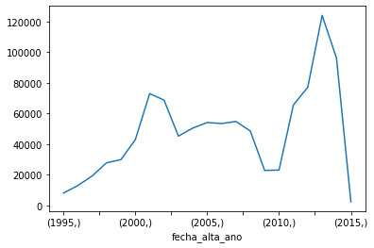
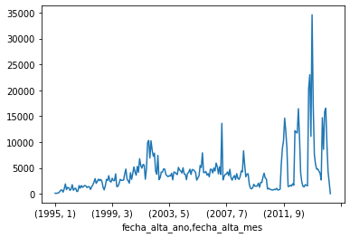
EDA: Monthly and Annual Trends in Customer Registration
Number of customer registrations by year and by month. Note that the period after 2011 has more registrations compared to before.

Slide 14
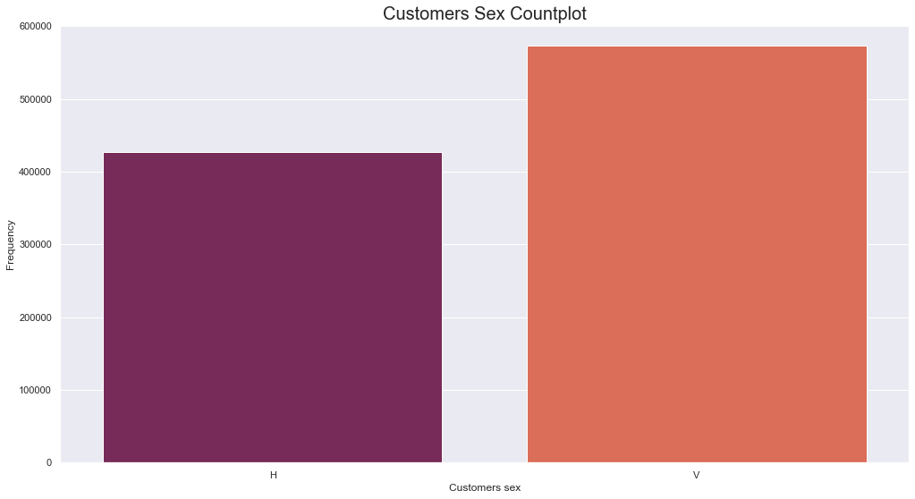
EDA:Customers Sex Category Distribution
Most of the customers below to sex category V

Slide 15
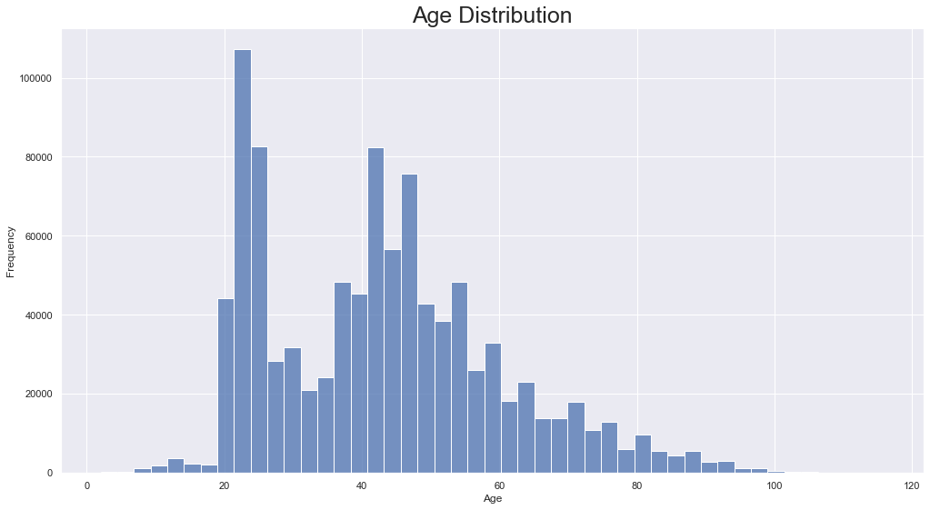
EDA: Customers Age Distribution
Most of the customers are between the age of 22-45

Slide 16
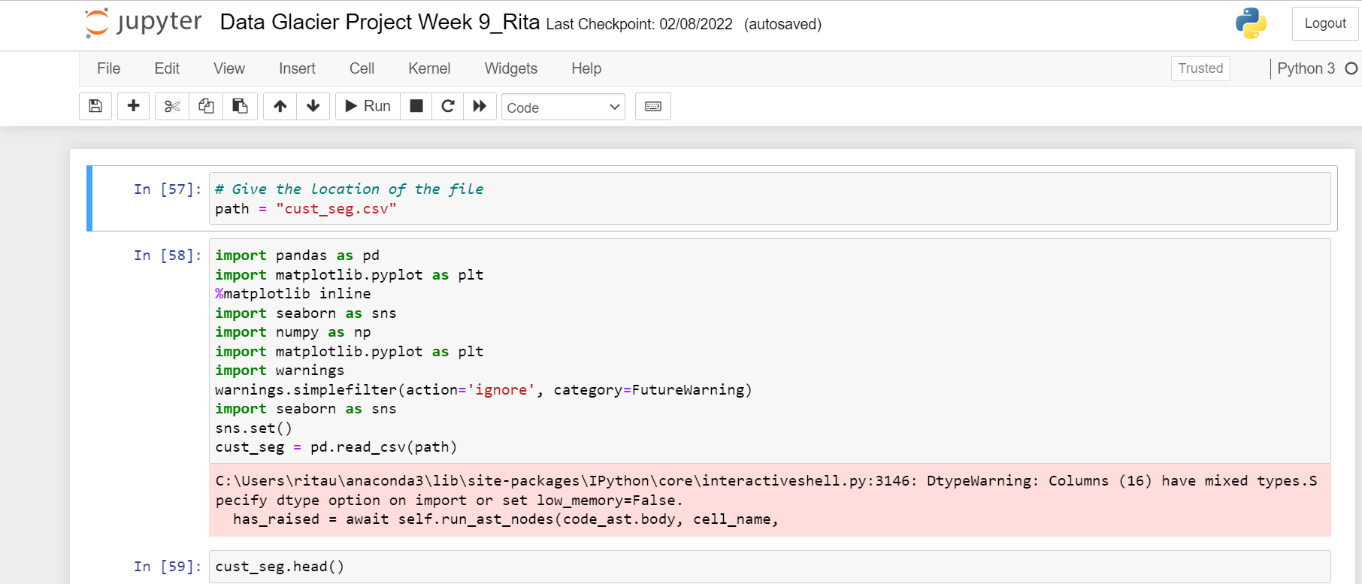
Tools and Techniques (Jupiter Notebook)
An integrated development environment (IDE) for Python
It comes with a console editor for executing the codes
Having a lot of open-source libraries to:
Read, write
Integrate
Validate, clean the data
Perform arithmetic calculations
Perform Machine Learning .
Perform DQL(Data Query Language)

Slide 17
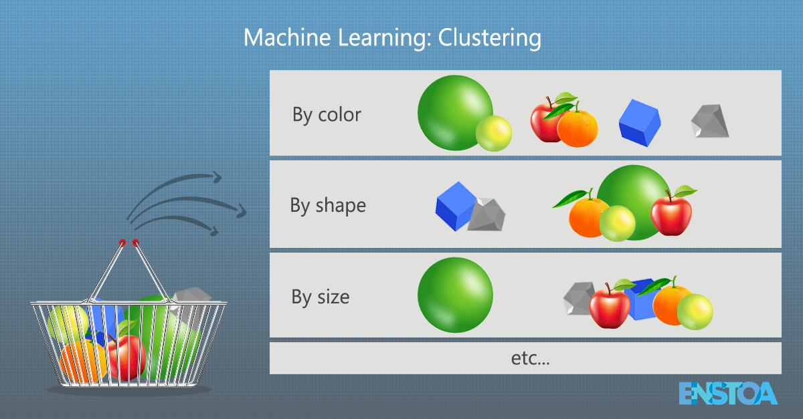
Tools and Techniques (Clustering: a machine learning model)
The data provided has some unnamed columns which made us conclude to use an unsupervised algorithm.
K-means clustering is an unsupervised clustering algorithm and that it belongs to the non-hierarchical class of clustering algorithms.
K-means clustering is one of the most widely used unsupervised machine learning models that form clusters of data based on the similarities between data instances.
For this particular algorithm to work, the number of clusters has to be defined beforehand. The K in the K-means refers to the number of clusters.
stackabuse.com
K-means clustering is one of the most widely used unsupervised machine learning algorithms that forms clusters of data based on the similarity between data instances.
For this particular algorithm to work, the number of clusters has to be defined beforehand. The K in the K-means refers to the number of clusters.
stackabuse.com
K-means clustering is one of the most widely used unsupervised machine learning algorithms that forms clusters of data based on the similarity between data instances.
For this particular algorithm to work, the number of clusters has to be defined beforehand. The K in the K-means refers to the number of clusters.
stackabuse.com
K-means clustering is one of the most widely used unsupervised machine learning algorithms that forms clusters of data based on the similarity between data instances.

Slide 18
Implementation: Extraction
The customer segmentation data was extracted from the source system into the virtual machine local system and read into Jupitar Notebook.

Slide 19
Implementation: Transformation
The Python programming language was used for data transformation, cleaning and data quality checks.
Steps in our data transformation stages
Data Aggregation
Data Quality
Data Deduplication
Data Cleansing
Data Filtering

Slide 20
Implementation: Transformation
We found that the issue with the original data set were:
Data Incompleteness - various columns, such as the ind_empleado (Employee index), pais_residencia (Customer's Country residence), sexo (Customer's sex) etc., have empty values (NA) in certain records.
Mitigation: Impute the missing values based on distribution in the training dataset. Depending on the context of the attribute, fill in the missing values with an appropriate value. If the variable is categorical, use the mode. If the variable is quantitative, use the median if discrete, and the mean if continuous.
Recommendation: Make input for such fields required, especially easily obtainable ones such as customer sex. If information cannot be obtained, then do not include. Alternatively, may consider removing some attributes which are not so important.

Slide 21
Implementation: Transformation
Inconsistent data types
Mitigation: Make data transformations to ensure consistent data types in each column. Examples: Convert selected records in strings to numeric, and remove non-numeric characters from the string.
Recommendation: Ensure that fact tables in the given database have constraints on data types. Having different data types for a given field makes it difficult to interpret results at the later stage.
Inconsistent values for the same attribute (e.g. -999999 as a value for seniority in months).
Mitigation: The seniority in months cant have a negative number. Use regular positive numbers to replace extended values into positive numbers or zero to ensure consistency across seniority in months. Or replace -999999 with NA and perform the missing data transformations as above using the median
Recommendation: Enforce a mandatory field where only positive integers are valid for this attribute.

Slide 22
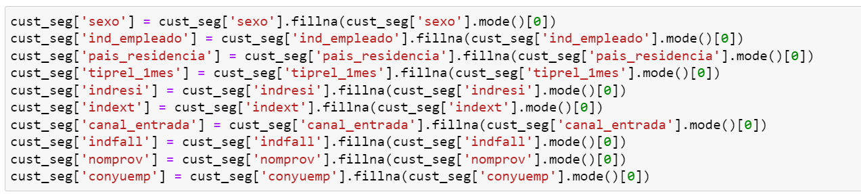
Implementation: Data Quality
Replacing With Mean
This is the most common method of imputing missing values of numeric columns. If there are outliers then the mean will not be appropriate. In such cases, outliers need to be treated first.
renta and indrel_1mes features are numeric columns with outliers,hence replacing with mean will not be appropriate.
Replacing With Mode
Mode is the most frequently occurring value. It is used in the case of categorical features.
You can use the ‘fillna’ method for imputing the categorical columns ‘sexo’, ‘ind_empleado’,‘pais_residencia’,'tiprel_1mes','indresi','indext','canal_entrada','indfall','nomprov','conyuemp'.

Slide 23
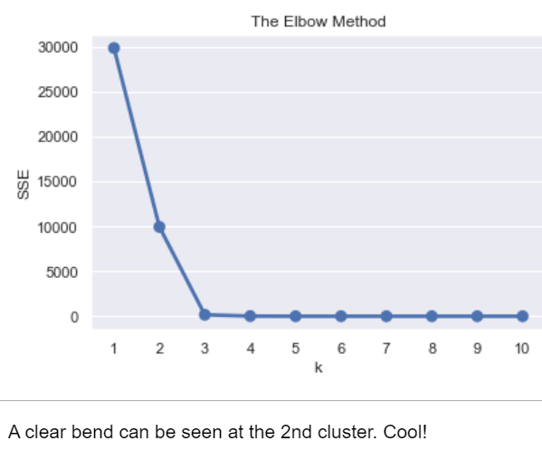
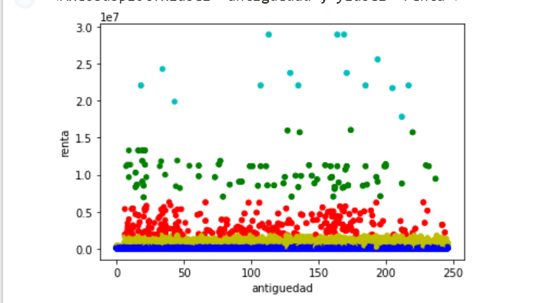
Implementation: K-Means Clustering
STEPS:
Gather the data(transformed data)
Manage skewness and scale each variable,
Explore the data,
Cluster the data,
Interpret the result

Slide 24
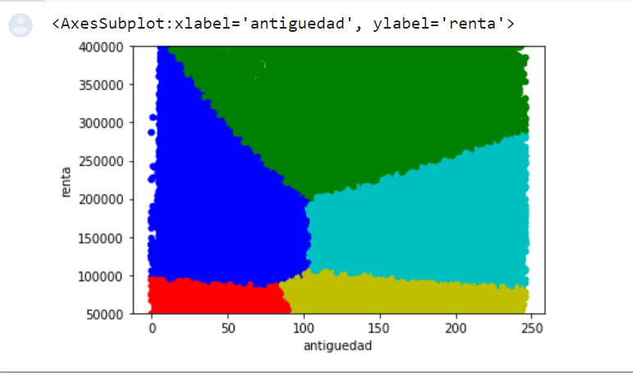
Results: Finding similarities between income and Seniority.
Based on this clustering results, the five groups which we could split the customer segment are:
Customers with lower income (under 100,000)andlessseniority(under96months)∗Customerswithlowerincome(under100,000) and more seniority (over 96 months)
Customers with medium income (between 100,000and250,000) and less seniority (under 96 months)
Customers with medium income (between 100,000and250,000) and more seniority (over 96 months)
Customers with higher income (over $250,000)

Slide 25
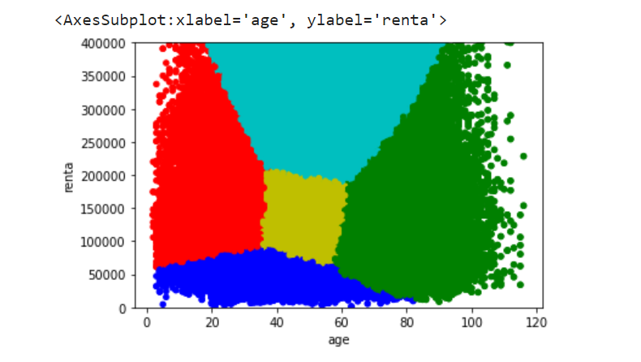
Results: Finding similarities between income and Age.
Based on this clustering, we could also segment the customers by the following groups:
High-income (above 250,000)customers∗Oldage(above60)customerswithhouseholdincomenotexceeding250,000
Low income (under $70,000) customers with age not exceeding 60
Other middle aged (35-60) customers
Other young (under 35) customers

Slide 26
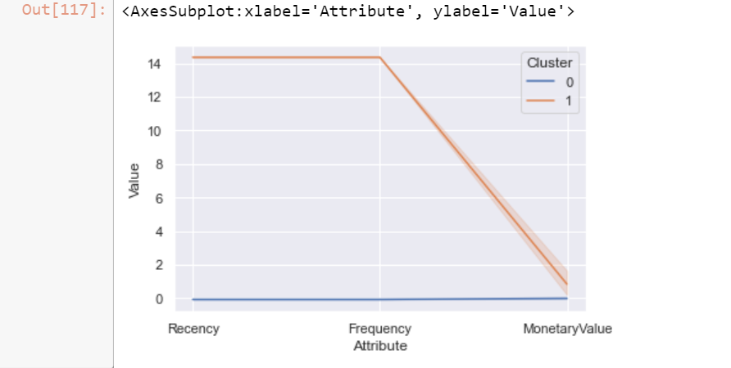
Results: Finding similarities in Active customers.
By using this plot, we know how each segment differs. It describes more than we use the summarized table.
We infer that cluster 0 is they are new customers, less active, made no deposits. Therefore, it could be the cluster of a new customers.
Finally, the cluster 1 is old customers, more active, but less deposits. Therefore, it could be the cluster of Repeat customers.

Slide 27
Conclusions
We created customer segmentations based on:
Their income and seniority
Their income and age
How active they are as a customer(Monetary wise as well)
The above segmentation can help shape on personalized gifts to increase customer relationship, cross selling, customer referrals etc.

Slide 28
Thank You

